Slide 1
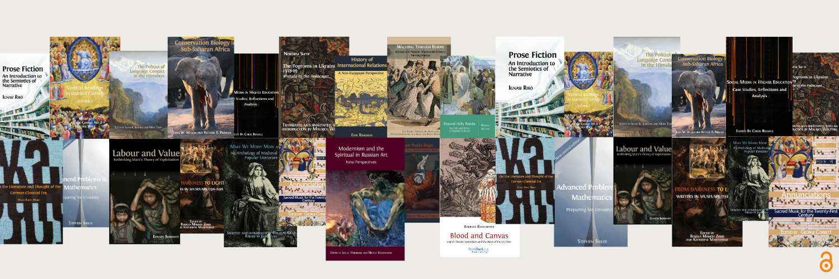


Making OA Textbooks a Reality
Rupert Gatti
Open Book Publishers
www.openbookpublishers.com

Slide 2

Overview
Making OA Textbooks
  OBP intro
  Other UK based non-profit publishers
Using OA Textbooks
  Discovery
  Adoption
Conclusion
  Collaboration is the way ahead
  Call to Action!
Photo by Slavcho Malezan on Unsplash

Slide 3

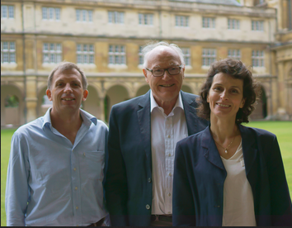
Open Book Publishers
Leading scholar-led, non-profit Open Access press
15+ years’ experience
Mission-driven: make high-quality research freely available everywhere
No charges to readers or authors
Rupert Gatti, William St Clair and Alessandra Tosi

Slide 4
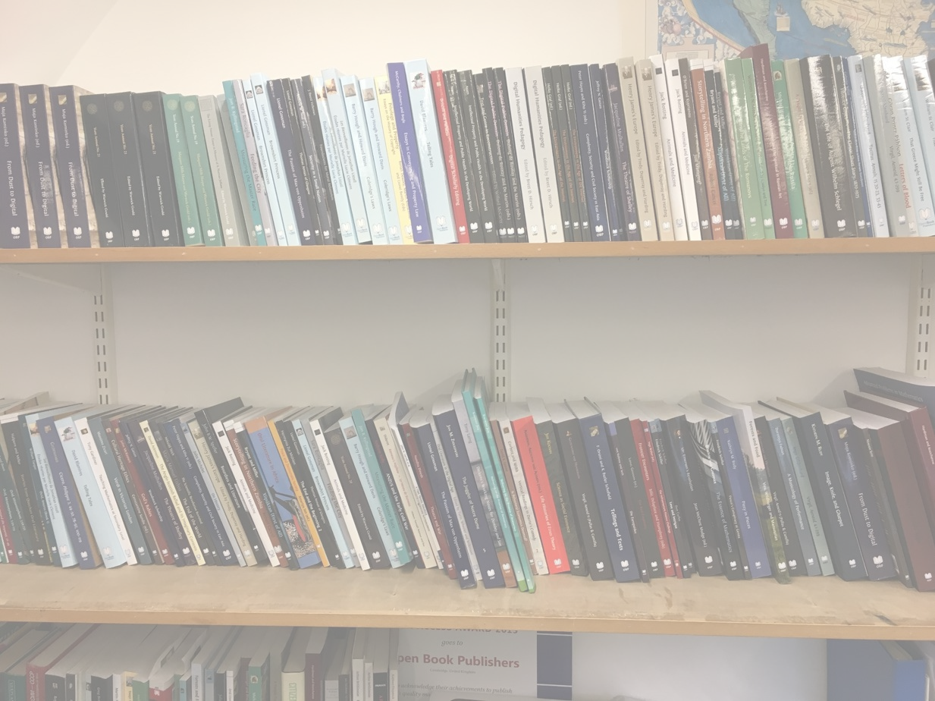

Our books
Over 400 titles published – of which 33 are textbooks
Publishing 50 peer-reviewed books per year
Blind peer-review process:
  Proposals reviewed by Managing Editor and Board
  Full manuscript sent to at least two expert reviewers
All immediate OA:
  No embargo
  Creative Commons licence
  Free PDF, HTML editions; paid-for paperback, hardback, EPUB
Accessed worldwide over 80,000 times each month
Available via open platforms and sales routes
  Google Scholar, OAPEN, Open Edition etc
  Amazon, our website, bookshops, museums etc
Notes:
LS – otherwise in-house

Slide 5
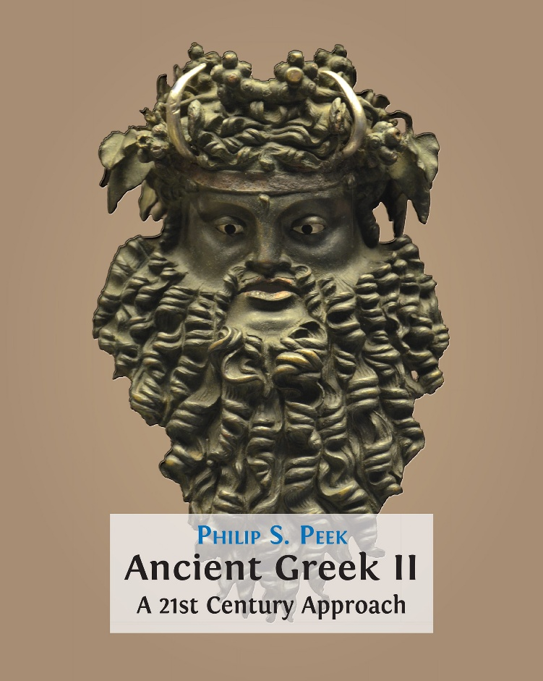
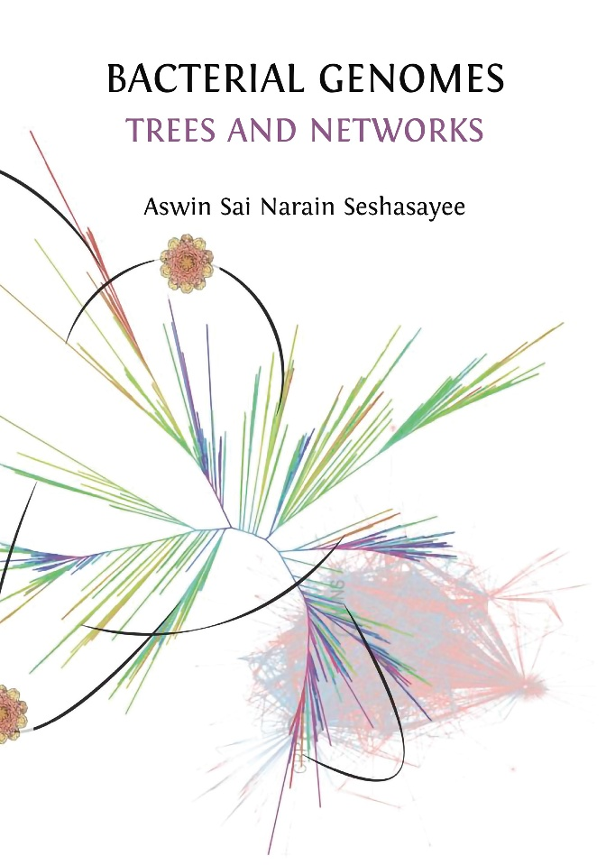
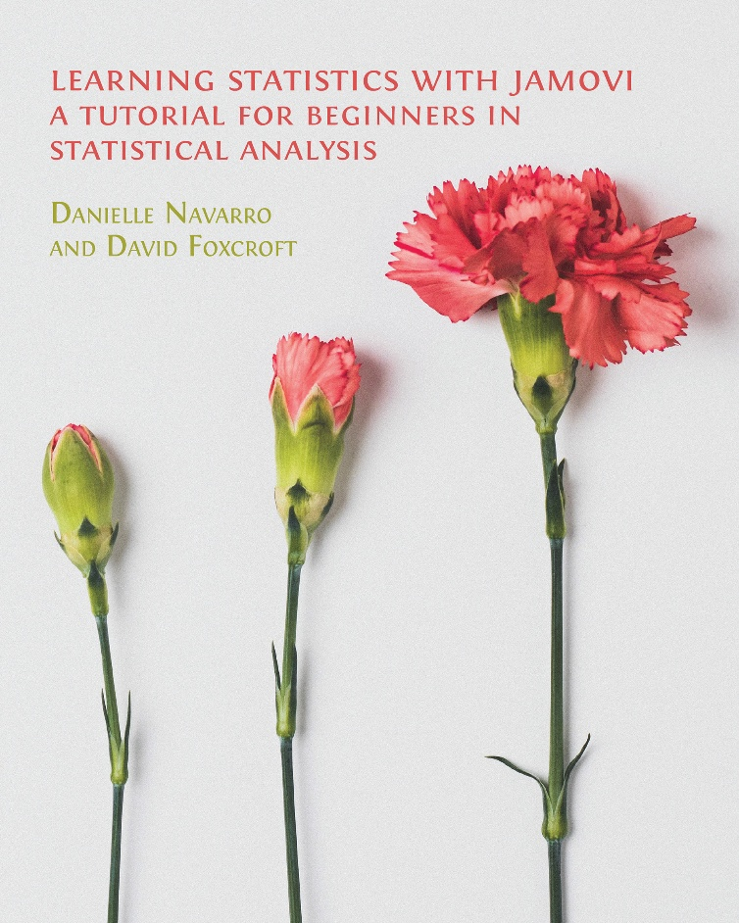

Most recent textbooks

Slide 6
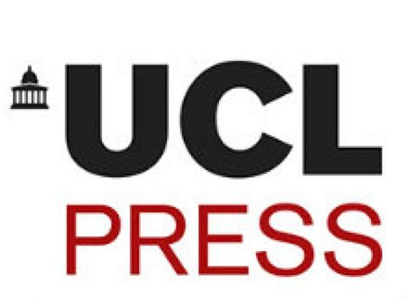

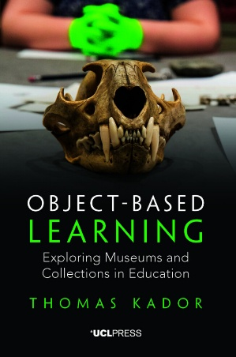

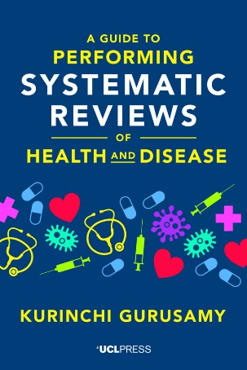






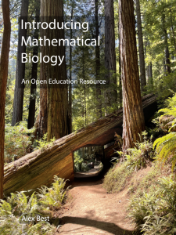



Many other UK non-profit OA textbook publishers
Pressbooks Network

Slide 7

Making OA textbooks a reality also requires …
Discovery
Adoption
Adaption
Updates
Additional resources

Slide 8

Discovery
Standard academic search channels are NOT very helpful
no specific textbooks metadata field in any of the book metadata formats (ONIX, MARC, etc)
Commercial solution: direct marketing
Typically no budget for OA publishers
Photo by Ali Hajian on Unsplash

Slide 9

What is an OA Textbook?
No standard definition
so all platforms have their own definitions
What is OA?
CC-BY only / other CC licences
What is a textbook?
Publisher defined or user defined?
Photo by Maiye Jeremiah on Unsplash

Slide 10

Discovery - solutions
Curated OA textbook platforms such as:
  MERLOT, Open Textbook Library,
  BC Campus OpenEd, College Open Textbooks, OER Commons
Useful LIBER guide
https://libereurope.eu/wp-content/uploads/Call-to-Action-for-Libraries-Improve-the-Discoverability-of-Open-Textbooks.-A-Step-By-Step-Guide.pdf
Conclusion:
Lecturers need support (from librarians)
Photo by Yury Nam on Unsplash

Slide 11

Assessment/Adoption
Issues for lecturer to consider:
  Initial filtering of possibilities
  Content: coverage and applicability
  Additional resources
  Ability to adapt text
  Strategy/Frequency of updates
Difficult to observe the adoption of
OA titles
  no reason for lectures/libraries to contact the publisher!
Photo by Glenn Carstens-Peters on Unsplash

Slide 12





Conclusion: collaboration is key
Supportive networks: knowledge-sharing, mutual support
We can do more together than separately
Collaboration between libraries, non-profit publishers, open infrastructures
Copim: Non-profit, open infrastructure to support small to medium-sized publishers
OPEN ACCESS BOOK NETWORK

Slide 13
Collaboration needs Coordination
Workshop last month in Salford identified three key initial questions we collectively need to address to start this process:
What content is already there?
This involves mapping what is already available, making this more discoverable, and fostering a culture that embeds OA textbooks/OER and the adoption of open resources.
What is missing?
This involves identifying gaps and setting up pilot projects to create new or adapted OA textbooks and OER, and then encouraging the adoption and reuse of this content.
Who will coordinate this?
The OEN UK Community of Practice was identified as a potential focus for collaboration and coordination around these activities.

Slide 14

Call to Action!
What OA textbooks are presently being used in UK universities?
Librarians: How might you obtain that data within your university? – and then:
Send a list to David Beales and the UK OEN

Slide 15



Thank you for listening!
Any questions…?
rupert@openbookpublishers.com
www.openbookpublishers.com
@rupertgatti.bsky.social

