Slide 1


Navigating AI in Academic Publishing: Open Book Publishers - a use case
Rupert Gatti
rupert.gatti@openbookpublishers.com
BlueSky: @rupertgatti.bsky.social

Slide 2
Introduction
AI is both enhancing efficiency and presenting ethical challenges for scholarly publishers
I will be looking specifically at our experience at Open Book Publishers, see also
https://blogs.openbookpublishers.com/navigating-ai-in-academic-publishing-balancing-efficiency-expertise-and-ethics/
Also – University of Michigan Press experience:
https://ebc.press.umich.edu/stories/2025-01-29-ai-and-the-university-press-a-michigan-case-study/

Slide 3
Outline
OBP Intro
How is OBP using AI?
Some legal considerations
Some ethical considerations
Conclusion

Slide 4
Open Book Publishers: Intro https://www.openbookpublishers.com/
OBP is a Scholar-led, non-profit, open access publisher of (peer reviewed) scholarly books
over 350 title published
publishing about 50-60 titles per year
Approach to AI: Handle with care!
Cautious yet practical AI integration
Conclusion: AI can helpfully support, but not replace, human expertise

Slide 5
AI in OBPs publishing workflow
Examples of AI applications in OBP:
Crafting initial drafts for book blurbs
Creating alt-text for accessibility
Assisting with index topic/names lists
Expanding access through AI-generated audiobooks
Marketing & social media activities
Automated tools: spell checks, citation & metadata extraction, url checking
Coding for development projects
Not presently using LLMs for copy-editing or research quality assessment – but some publishers are:

Slide 6
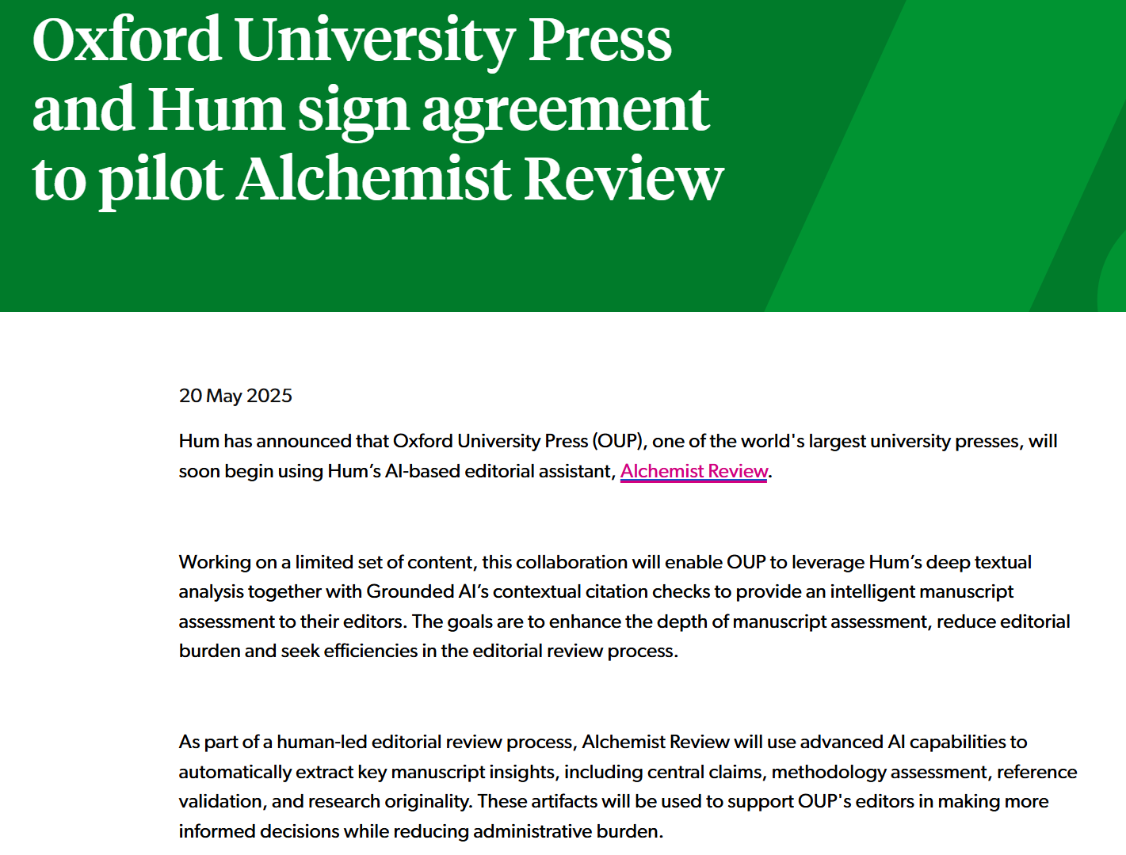
https://www.alpsp.org/news-publications/industry-news/oxford-university-press-and-hum-sign-agreement-to-pilot-alchemist-review/

Slide 7
Authors’ & Reviewers’ use of AI
Authors and Reviewers may be making use of AI for:
the underlying research itself
the preparation/writing of the manuscript/report
When is this a good or bad thing?
  No clear agreement over accepted practice or on acceptable boundaries for research assessment within academia generally
For last 6 months we have asked all authors to self-report their use of AI in the creation of their manuscript and research
  Have not yet asked reviewers (but maybe we should!)
Reported uses:
translations
grammatical checks and correction (esp. non-native English speaking authors)

Slide 8
Readers’ use of AI
AI Tools are now provided in browsers, pdf/book readers, search engines, etc.
Readers interactions with books increasingly intermediated by AI engines.
What does that mean for the way we publish content?
should we create AI optimised content/formats?

Slide 9
Assessing/recognising AI generated manuscripts
This is something we are concerned about, and have no specific solutions for.
Book-mills: I am aware of several publishers that are generating large numbers of titles across multiple discipline with identical authors, or invented scholars.
We believe we are beginning to see AI generated manuscripts submitted to OBP – but not known with certainly
Existential Questions: What/why are we publishing books?
human vs AI generated research
human vs AI write-up of research

Slide 10
Some Legal issues: Copyright
‘Fair dealing/use’ and ‘text/data-mining’ copyright exemptions being tested in law courts globally
Some early rulings (eg Thaler v. Perlmutter in US) that AI generated works can NOT be copyrighted, unless significantly altered by human author
copyright designed to protect human activity
Interesting aside: concern raised by ChatGPT that DeepSeek used ChatGPT outputs to train the DS model! (good for geese and ganders?)

Slide 11
Report from US Copyright Office on use of copyright material by AI
Copyright and Artificial Intelligence Part 3: Generative AI Training Report pre-publication version. May 2025
https://www.copyright.gov/ai/Copyright-and-Artificial-Intelligence-Part-3-Generative-AI-Training-Report-Pre-Publication-Version.pdf
Conclusion: It depends!
Recommendation: Let licencing agreements develop

Slide 12
Conclusion: It depends
Various uses of copyrighted works in AI training are likely to be transformative. The extent to which they are fair, however, will depend on what works were used, from what source, for what purpose, and with what controls on the outputs—all of which can affect the market.
When a model is deployed for purposes such as analysis or research—the types of uses that are critical to international competitiveness—the outputs are unlikely to substitute for expressive works used in training.
But making commercial use of vast troves of copyrighted works to produce expressive content that competes with them in existing markets, especially where this is accomplished through illegal access, goes beyond established fair use boundaries. (p107)

Slide 13
Recommendation:
Let licensing agreements develop
Licensing agreements for AI training, both individual and collective, are fast emerging in certain sectors, although their availability so far is inconsistent.
Given the robust growth of voluntary licensing, as well as the lack of stakeholder support for any statutory change, the Office believes government intervention would be premature at this time. (p107)

Slide 14
Some Legal issues: CC licences
Creative Commons Org:
still considering their position – but basically waiting to learn what is allowed under copyright law.
Issues:
BY attribution required even with a CC BY licence
NC licence seems likely to be the one with most bite,
ND the nature of the derivative may matter (is an AI generated summary of a work a derivative of the work?)
SA licence – has bite if AI can’t have copyright?
https://creativecommons.org/2023/08/18/understanding-cc-licenses-and-generative-ai/

Slide 15
Some Legal Issues: Contracts
Some distributors refusing AI generated content, eg:
  Lightning Source (Ingram owned) POD printer
LLMs contracting with (largest) publishers to use content for training
Not aware of this with any OA content/publisher
Not presently including anything specific in our own author contracts

Slide 16
Ethical Considerations within OBP:
1. Humans v machines
Balancing efficiency with human expertise:
  Presently AI is improving workflow and work experience for existing employees
Replacement of human employment?
  nowhere near that for existing workflows
  creating new outputs and formats, not replacing employees/professionals (eg audiobooks, improved accessibility)

Slide 17
2. Business practices & the environment
Ethical LLM models?
  ChatGPT employment practices, closed model, US owned
  DeepSeek employment practices, open source, Chinese owned
  Government/company/training censorship/biases (not always transparent)
Environmental issues:
  difficult to assess – and changing
  is providing an audio book – or accessible content – better than requiring AI enabled browsers to do it for each reader?

Slide 18
Conclusion
OBP is:
Encouraging ongoing dialogue on AI ethics and practices in scholarly publishing
Recognising that issues are changing and evolving rapidly
Investigating, experimenting and introducing AI cautiously and in consultation with employees and authors
Position: AI is providing useful tools to support publishing workflows, but all require human expertise and moderation in their application

Slide 19
AI-Generated Book Blurbs
AI (Chat-GPT) drafts initial blurbs based on key information
  (book proposal, introduction etc)
AI drafts some chapter abstracts
  (but usually ask authors to do this)
Human editors and authors review and refine these drafts to capture the book's essence

Slide 20
AI-Assisted Index Topics Lists
Using ChatGPT for
preliminary index topics & names lists
generating keyword suggestions for metadata
Necessity for human oversight to refine AI-generated suggestions
But not (presently) good at accurately creating subject codes (Thema, BIC/BISAC, etc)

Slide 21
Enhancing Accessibility with AI-Generated Alt-Text
Alt-text makes visual content (eg images, graphs etc) accessible for visually impaired users
AI (ChatGPT) generates initial draft of alt-text, but human review ensures accuracy and relevance
Utilising accessibility checkers for epub and pdf files (Ace by DAISY, Adobe Indesign/Acrobat accessibility checkers)

Slide 22
Expanding Access with AI-Generated Audiobooks
Text-to-Speech (TTS) systems allow us to produce audiobooks cost-effectively
using free service by GooglePlay,
ElevenLabs results are better, but over £100 per book
Human oversight required to ensure quality and accessibility
In the process of assessing cost/benefit for a small set of titles.
  On Google Books – free audiobooks are being downloaded at a similar rate to free epubs
Notes:
OBP can not afford to create audiobooks using professional voice actors etc.
Browser-based text-to-speech readers available.
But some readers choose to engage with audiobook editions.

Slide 23
Marketing
Using AI (ChatGPT) to:
creating drafts of text targeted for different advertising campaigns e.g. social media, conference flyer, etc.
compiling lists of journals and societies for marketing purposes – although without careful prompting tends to prioritise Anglo-American journals.

Slide 24
Automated processing tools
Spell checking tools: useful for proof reading
Monitoring citation and metadata extraction tools: useful for backlist and pdf only titles
url extraction and checking tools
Translation tools

Slide 25
Software development
Our developers integrate AI (ChatGPT, Copilot) into their coding environments to streamline specific tasks, such as:
code explanation
generating snippets of code
automating test writing (a tedious activity that AI can handle efficiently)

