Slide 1
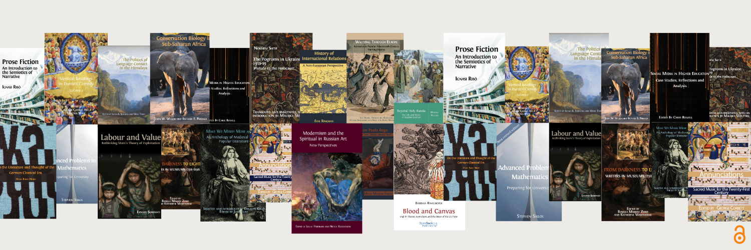

Distributing knowledge for equity
Two new books and an evolving concept for Open Science
openbookpublishers.com

Slide 2


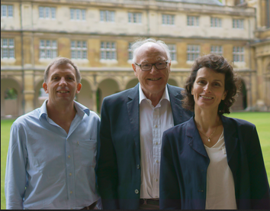
Open Book Publishers
Open Book Publishers
Leading scholar-led, non-profit
open access press
17+ years’ experience
Mission-driven: author-focused
Diamond OA: no charges for readers, no mandatory fees for authors
60 books per year
https://lnk.bio/openbookpublishers
Rupert Gatti, William St Clair and Alessandra Tosi

Slide 3
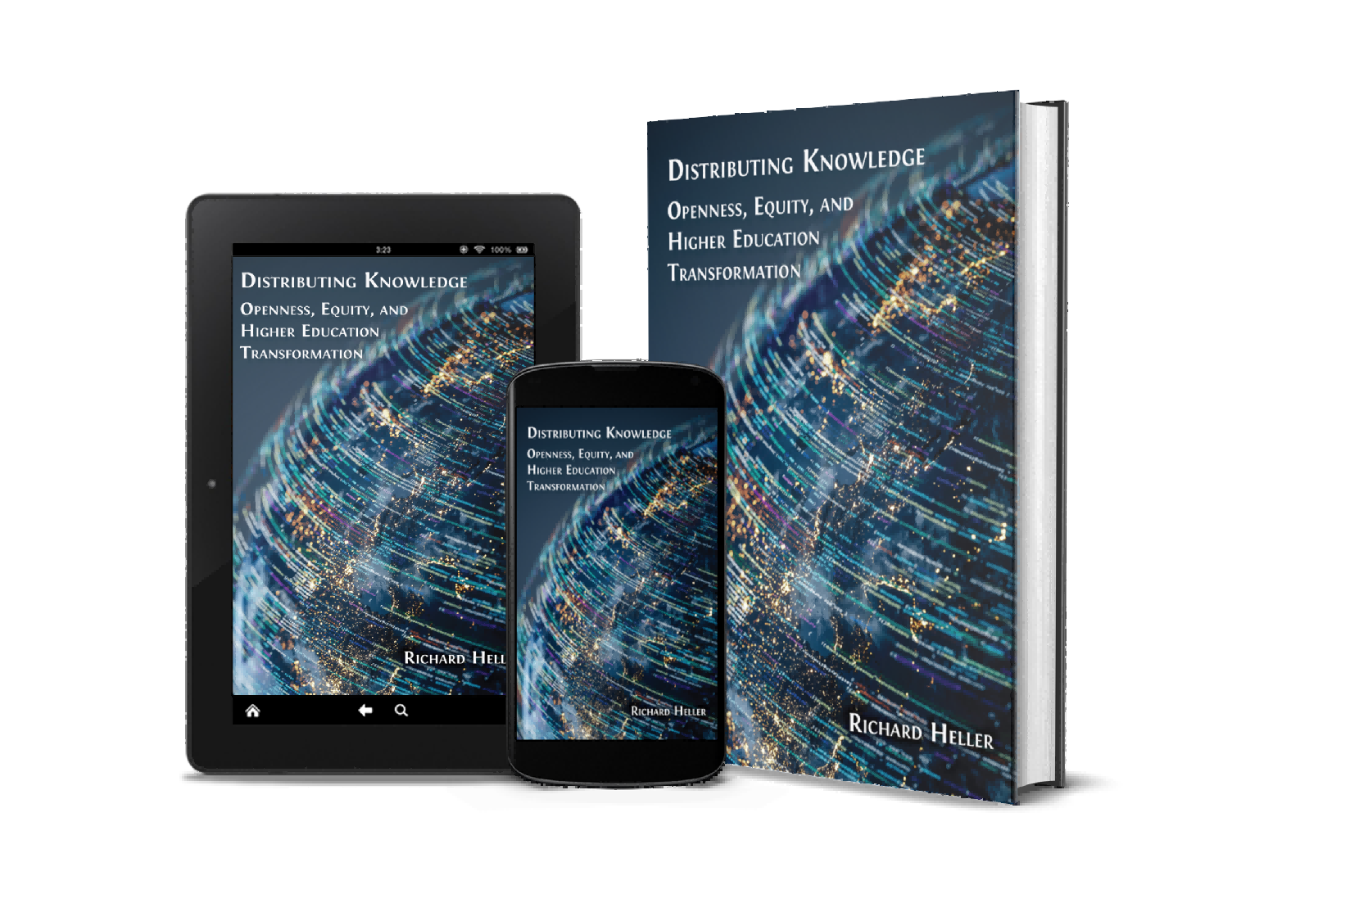
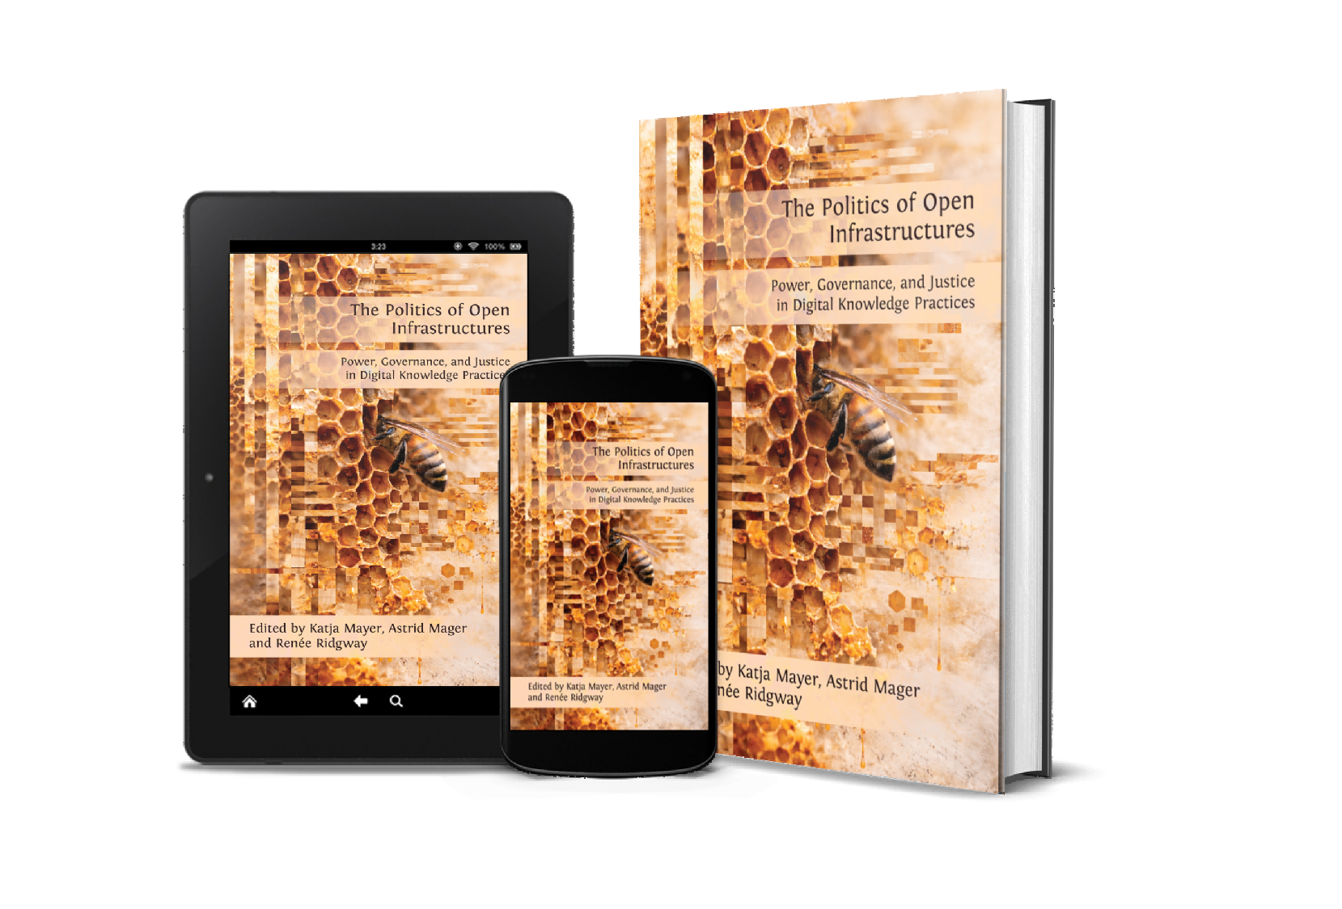
Open Book Publishers
Two recent publications
Distributing Knowledge: Openness, Equity,
and Higher Education Transformation
by Richard Heller,
https://doi.org/10.11647/OBP.0520
The Politics of Open Infrastructures: Power, Governance, and Justice in Digital Knowledge Practices
edited by Katja Mayer, Astrid Mager and Renée Ridgway, https://doi.org/10.11647/OBP.0528

Slide 4
Open Book Publishers
Today’s speakers
Ivonne Lujano, Post-doctoral researcher, El Colegio Mexiquense, Mexico, and Community Manager and Ambassador at the DOAJ
Igor Lyman, Head of Department of History and Philosophy, Berdyansk State Pedagogical University, Ukraine
Richard Heller, Emeritus Professor, Universities of Manchester UK, and Newcastle Australia
Daniel Otto, Professor of Educational Technology and Digital Education, European University for Innovation and Perspective
Omo Oaiya, Chief Strategy Officer, West and Central African Research and Education Network (WACREN)
Yana Suchikova, Vice-Rector for Research, Berdyansk State Pedagogical University, Ukraine

Slide 5





92
140
23,000
More than
languages
countries
journals

Slide 6

Inclusive knowledge infrastructures
An ongoing process of negotiation, adaptation, and the maintenance of standards
Invisible work carried out by DOAJ to navigate the tensions inherent in the politics of classification - e.g. “predatory”
Infrastructuring inclusivity through a participatory approach vs. impossible neutrality
Ambassador programme lesson: the importance of community-led organisations investing in their local communities

Slide 7
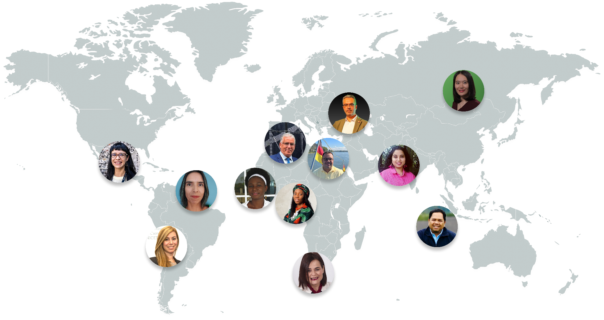

DOAJ ambassador programme
“Inclusive infrastructure can be built not only through technological design, but through deliberate attention to human relationships, local contexts, and institutional structures”
DOAJ Ambassadors 2026

Slide 8
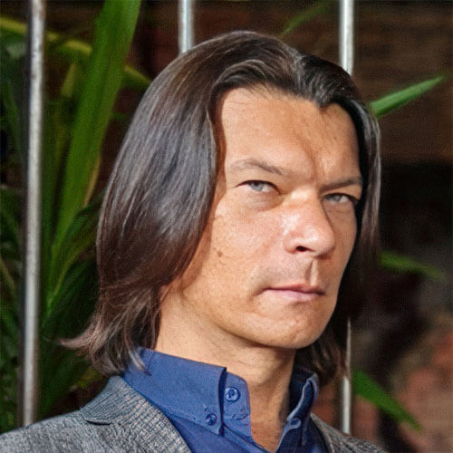

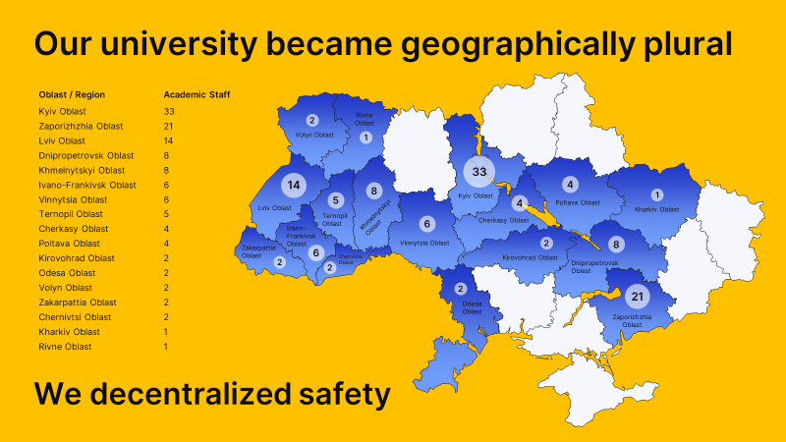
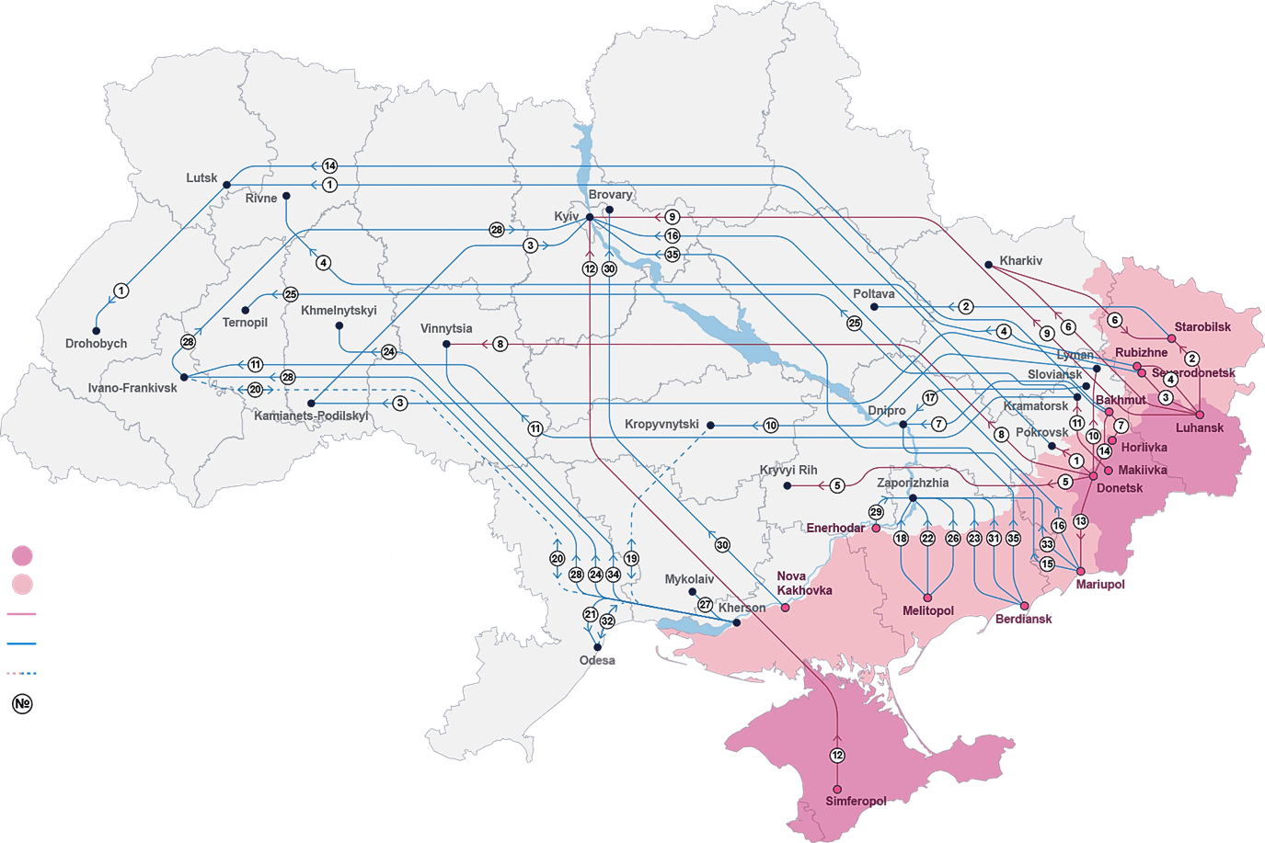
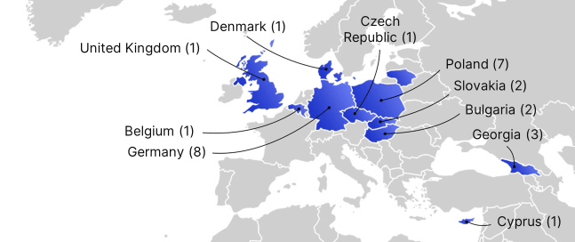
Igor Lyman
Ukraine’s displaced universities: learning across locations
Berdyansk State
Pedagogical University
Some universities relocated more than once
Staff and students dispersed across regions and countries
Teaching continued through different institutional models
BSPU: relocated to Zaporizhzhia, operating across many locations
And also in many other countries around the world
Map of relocated HEIs of Ukraine

Slide 9
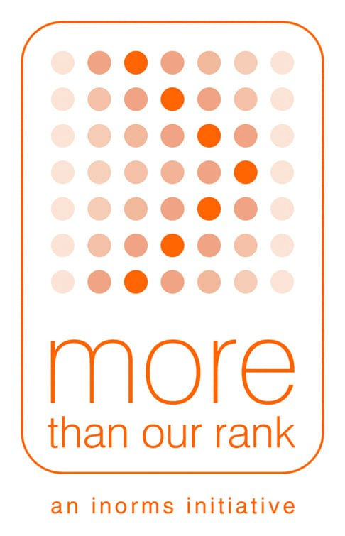

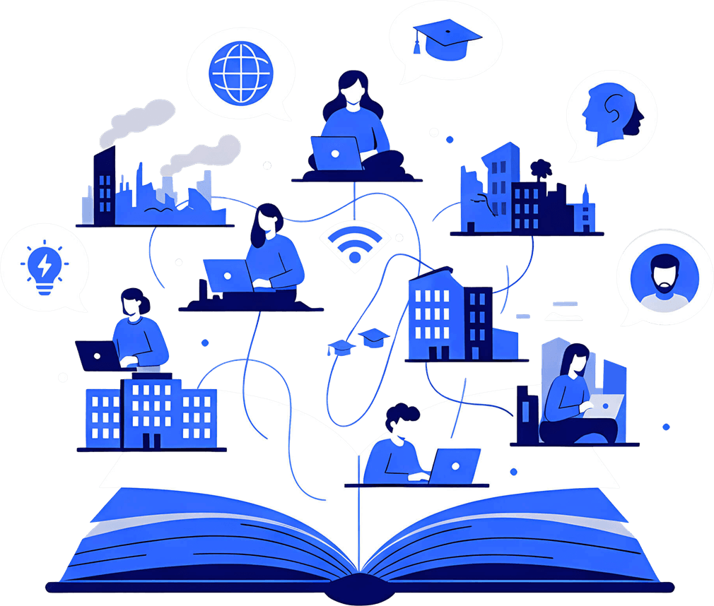

BSPU’s University Without Walls: how distributed learning works
Shared learning environment | Moodle materials and assignments. Live online classes and asynchronous study
Continuity of education | Teaching, assessment and student support across locations
Care and belonging | “I Am Here” psychological café. Academic and cultural gatherings in different cities
International exchange | Ukrainian–Australian dialogue, February 2026. Canberra symposium, University of Melbourne and Future Campus
!
Distributed learning needs shared resources, coordination and human support

Slide 10
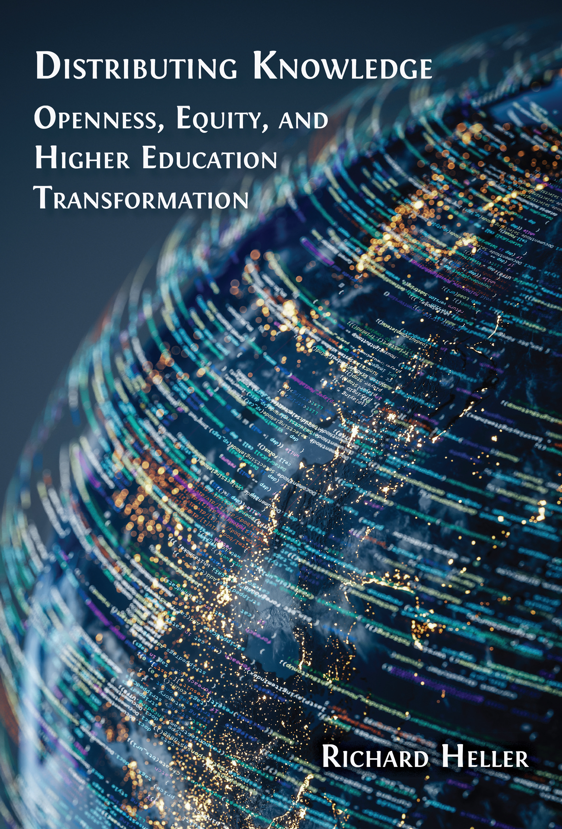

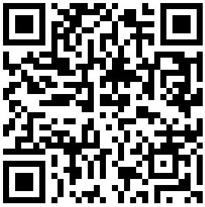
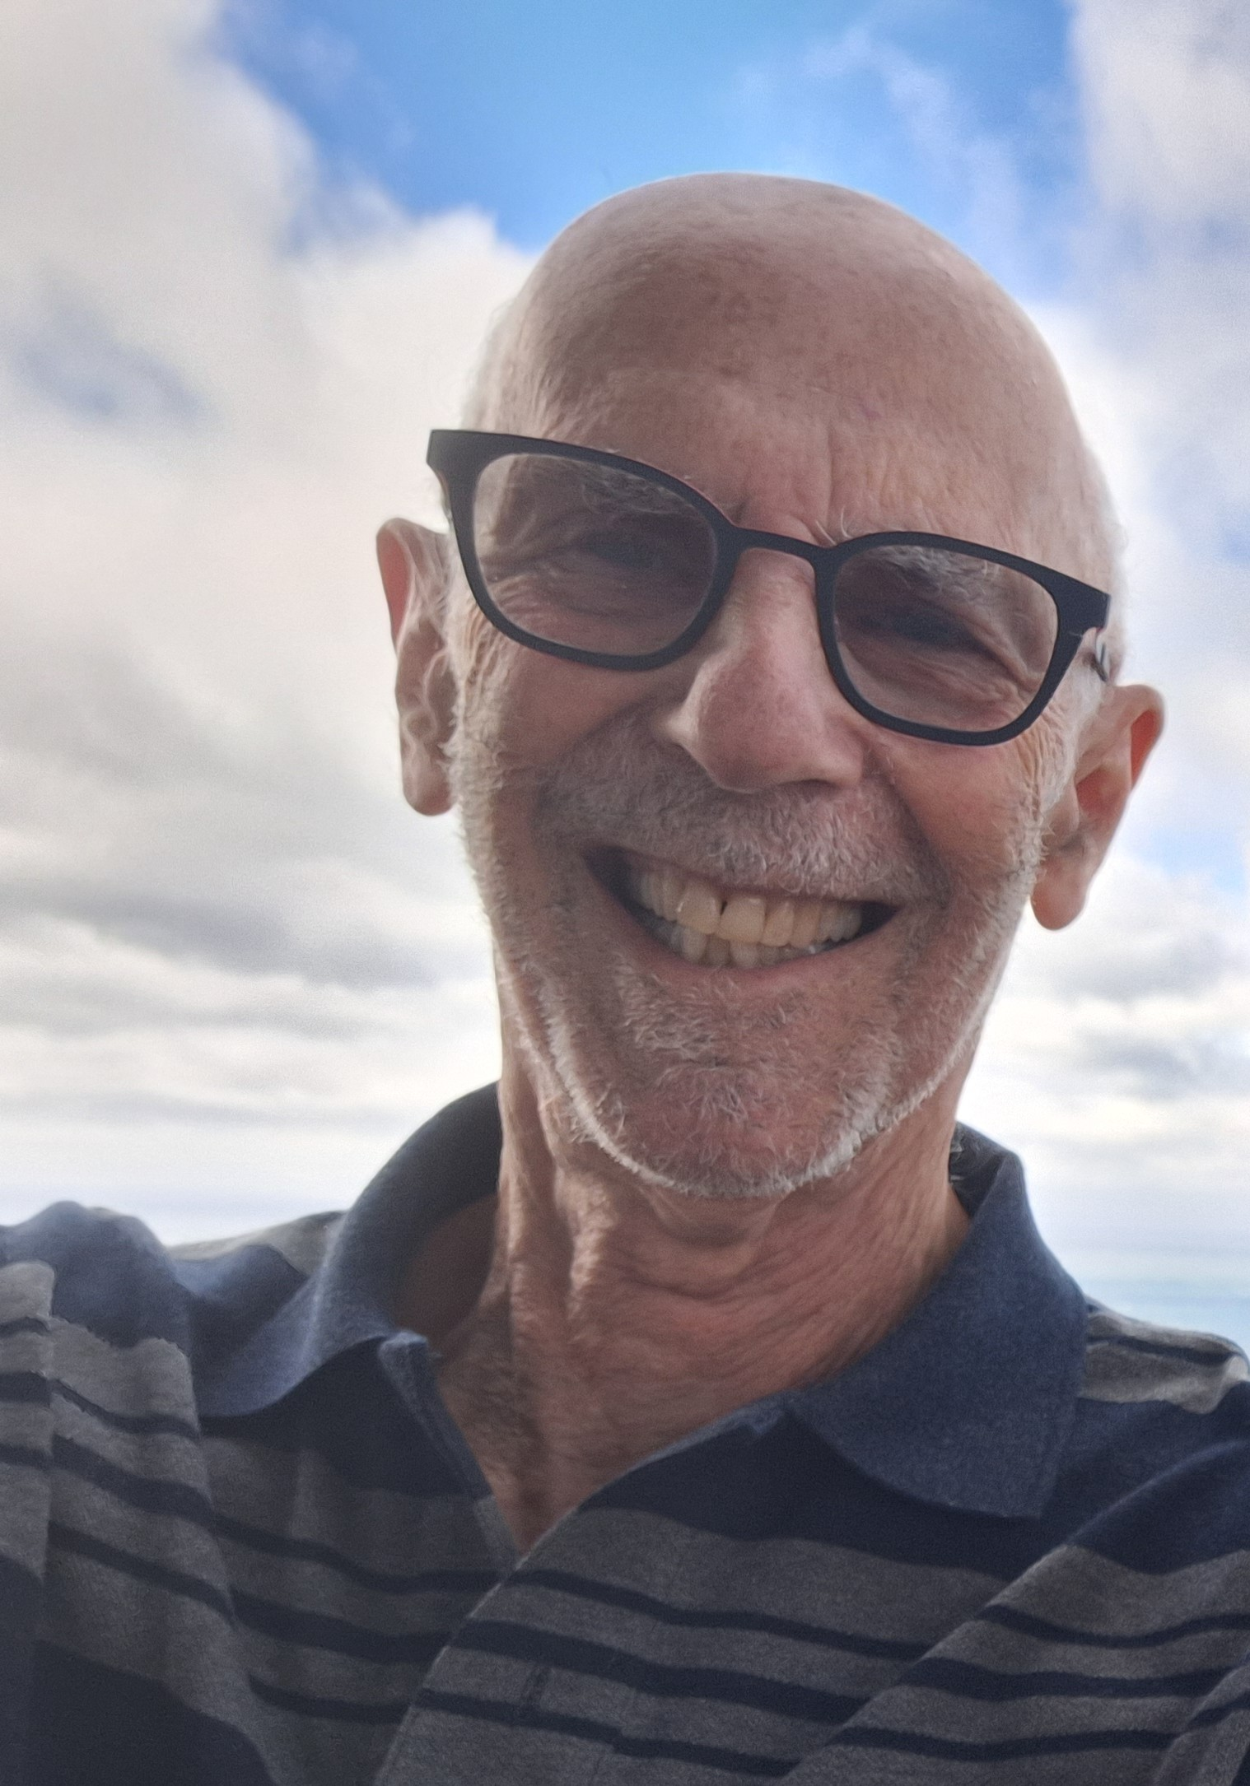
Distributing Knowledge
Openness, Equity, and Higher Education Transformation
Richard Heller
Emeritus Professor of Medicine, University of Newcastle, Australia, and
Public Health, University of Manchester, UK.

Slide 11
Rationale: higher education has become a commodity and should transform to meet global needs - with equity and openness as underlying principles
The book builds on the concept of the Distributed University, and takes the reader through a framework for distributing knowledge for equity
Part A. Values guiding knowledge equity
Part B. Reducing inequity in creating and publishing knowledge
Part C. Reducing inequity in access to education
Part D. Infrastructure requirements
Part E. How to make the transformation work

Slide 12
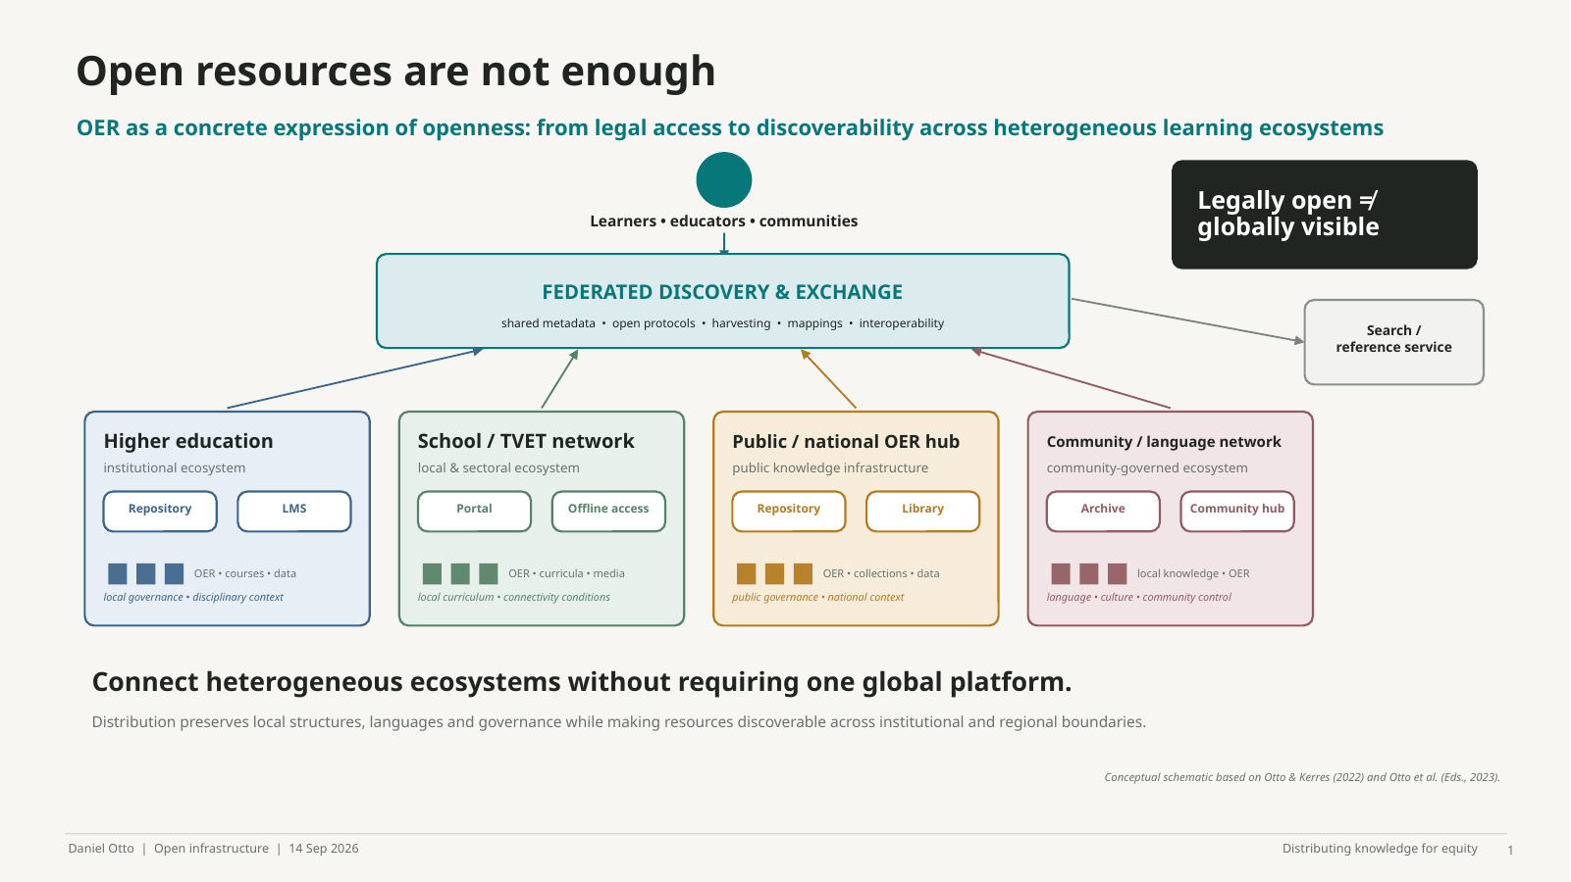
Notes:
Thank you. I want to start with a simple proposition: open resources are not necessarily accessible resources.
Within the broader idea of openness in education, Open Educational Resources are one concrete way of making knowledge shareable, reusable and adaptable. But our work on Distributed Learning Ecosystems started from an observation that seems almost paradoxical: we may have more and more open resources, while teachers and learners still struggle to find them.
So the problem is not only the existence of knowledge. It is also its visibility and discoverability. An educational resource can be openly licensed and freely available somewhere on the internet, but effectively invisible because it sits in an isolated repository, uses incompatible metadata, is not indexed by the services people use, or exists outside their familiar educational environment.
This is why we proposed the idea of a Distributed Learning Ecosystem. Rather than building another large central platform, the aim is to connect heterogeneous ecosystems: universities, schools and vocational education, public repositories, community and language networks. Distribution here means preserving local structures, languages and governance while creating interoperability between them.
So the question changes from: Where should we put all our open knowledge? to: How can different knowledge environments communicate with each other without requiring one dominant global platform?
And this matters for equity, because access does not begin when somebody clicks on a resource. It begins much earlier, with whether that resource can become visible at all.
Sources: Otto, D., & Kerres, M. (2022). Increasing Sustainability in Open Learning: Prospects of a Distributed Learning Ecosystem for Open Educational Resources. Frontiers in Education, 7, 866917. Otto, D., Scharnberg, G., Kerres, M., & Zawacki-Richter, O. (Eds.). (2023). Distributed Learning Ecosystems: Concepts, Resources, and Repositories. Springer VS.

Slide 13
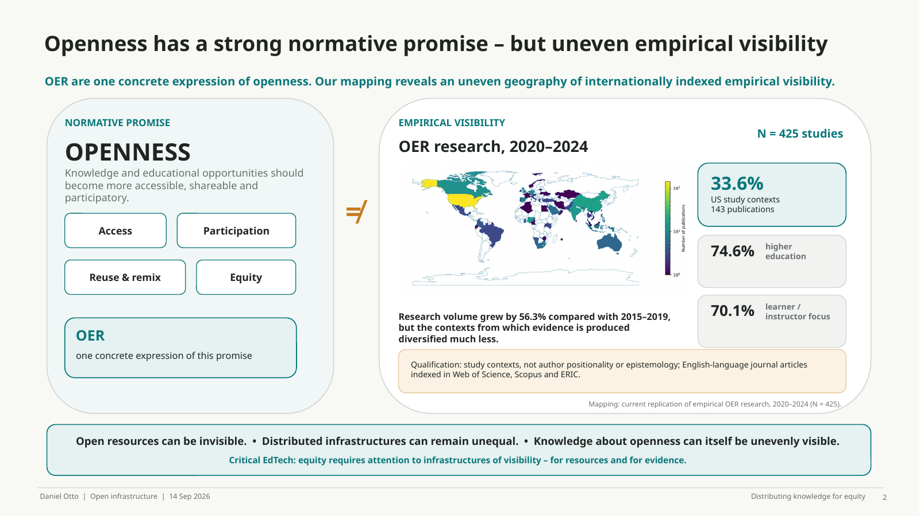
Notes:
This brings me to a tension that I find particularly important from a Critical EdTech perspective.
Openness has a strong normative promise: widening access, enabling participation, and making knowledge more freely shareable and reusable. OER are one concrete expression of this promise.
But when we look at the empirical research through which we understand OER, we find a much more uneven picture. In our recent replication of a systematic mapping, we identified 425 eligible English-language journal articles published between 2020 and 2024. The United States alone accounted for 143 publications, or 33.6 percent of the corpus. Almost three quarters of the studies were situated in higher education, and 70.1 percent predominantly investigated learners or instructors.
The field has expanded substantially, from 272 studies in 2015–2019 to 425 in 2020–2024. Yet this expansion has not been accompanied by an equivalent diversification of the contexts and perspectives from which evidence is produced.
So there is a tension here: a normative project that aspires to distribute knowledge more equitably is itself studied through an evidence base that remains structurally concentrated.
I want to be precise. Our mapping does not prove that OER scholarship is epistemically dominated by the Global North. We did not analyse author positionality or epistemological perspectives. And our corpus itself is situated: it consists of English-language journal articles indexed in Web of Science, Scopus and ERIC.
But this limitation is also revealing. Databases, languages, metadata standards, repositories and indexing systems are infrastructures of visibility. They influence not only whether educational resources can be found, but also which research becomes internationally visible.
This is where Distributed Learning Ecosystems become politically interesting. Federation should allow systems to remain locally governed and contextually meaningful while becoming interoperable with others, without requiring one dominant technical or epistemic model.
So my final point is: open resources can be invisible; distributed infrastructures can remain unequal; and knowledge about openness can itself be unevenly visible. Equity therefore depends not only on distributing knowledge, but also on distributing visibility and the capacity to participate in governing the infrastructures through which knowledge circulates.
Research source: current OER mapping replication, 2020–2024 corpus, N = 425. The mapping captures study contexts and predominant investigation foci, not author positionality or epistemological standpoint; the corpus is restricted to English-language journal articles indexed in Web of Science, Scopus and ERIC.

Slide 14






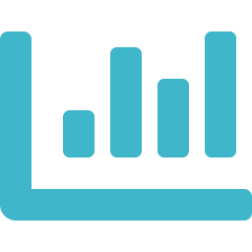

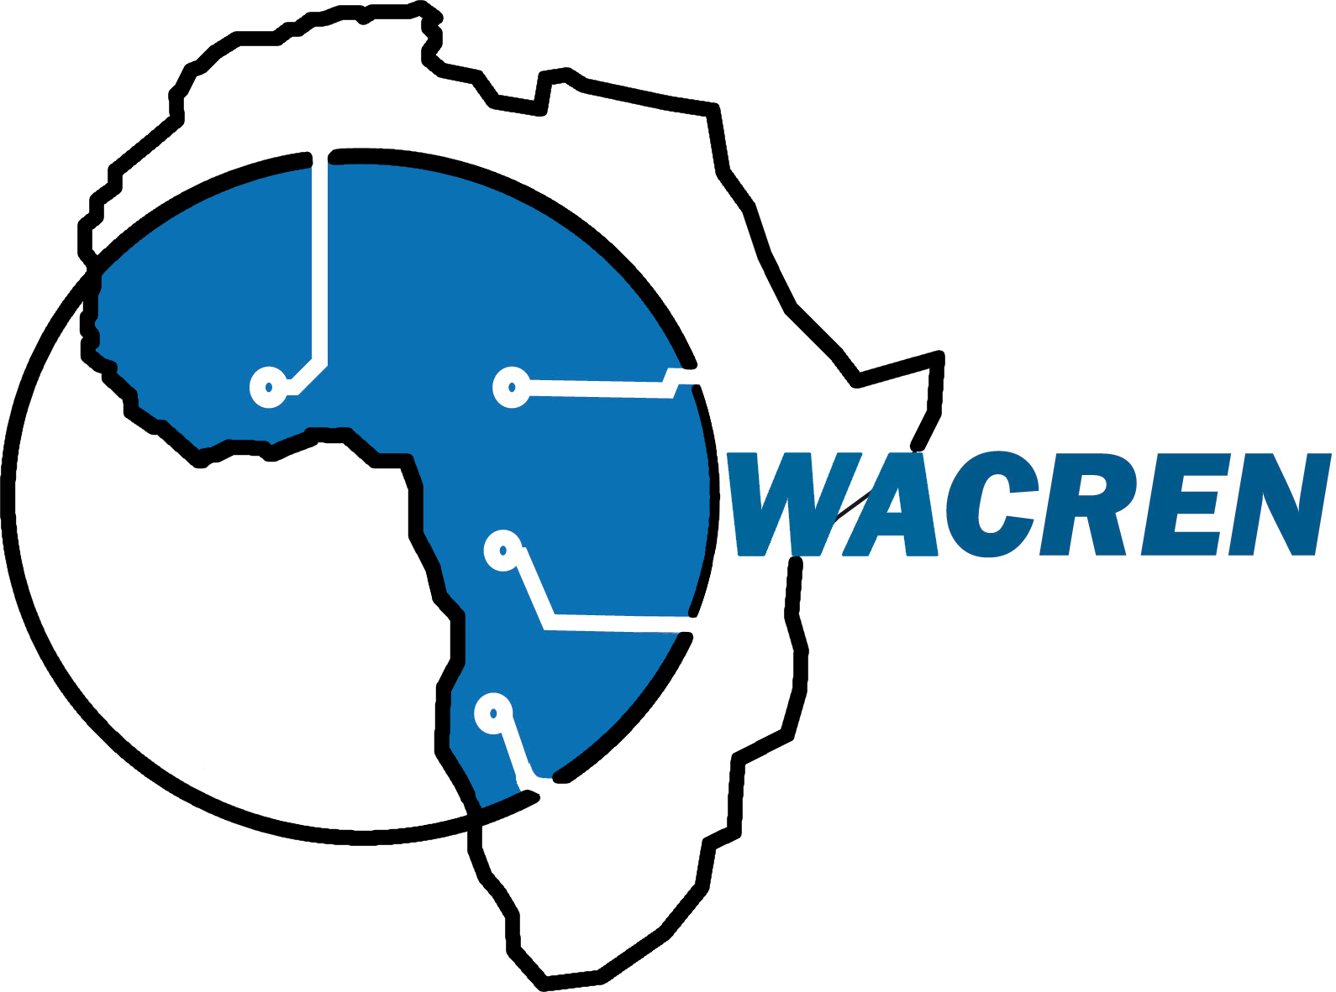
What might a genuinely distributed
university look like in Africa?
Scale the ecosystem, not just the institution.
Identity
Connectivity
Learning
Repositories
Publishing
PIDs
Research data
Compute/AI
● Locally rooted institutions — universities • researchers • students • libraries • communities
● Shared, federated infrastructure — the common layer every institution plugs into
● Distributed capability — learning • research • knowledge production • collaboration
“Cooperate without having to become the same institution.”

Slide 15
African Digital Campus: connecting what already exists
NOUN
NOUN — an initial environment for demonstrating the model at scale, not the entirety of the Campus
● Institutions — NOUN and participating universities
● National shared infrastructure — NRENs • federated identity • connectivity
● Regional infrastructure — WACREN / AfricaConnect • repositories • PIDs
● Global Open Science ecosystem — Diamond/open publishing • research data • shared compute/AI
Build locally
→
Federate nationally
→
Connect regionally
→
Interoperate globally
What if the capacity we need already exists — but needs to be connected and shared?
Notes:
.

Slide 16
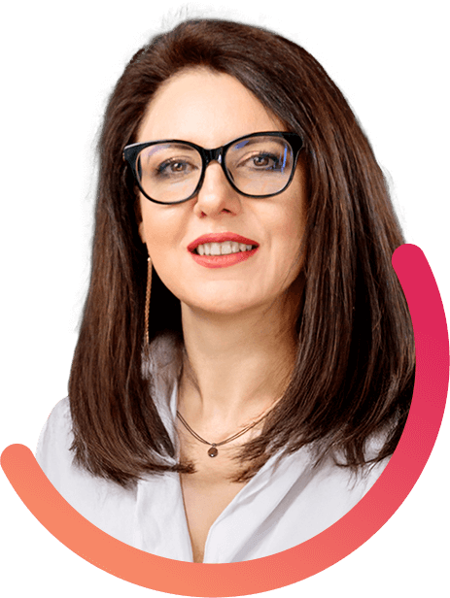

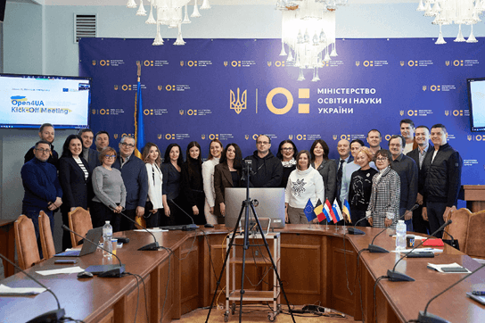
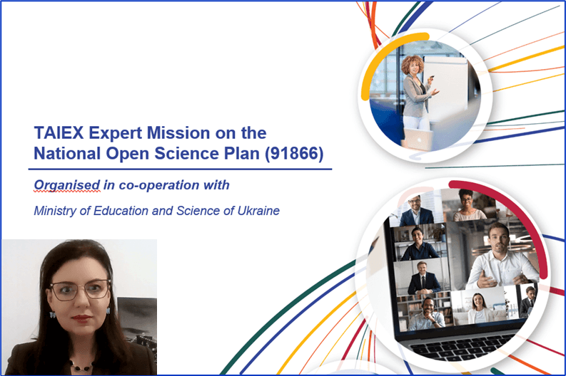
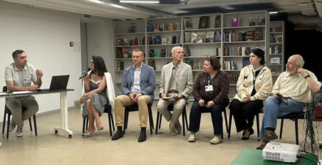

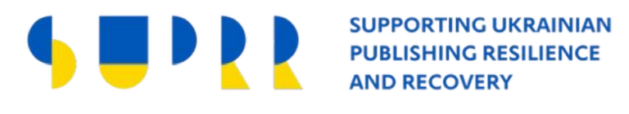

Open science in Ukraine: BSPU’s contribution during wartime
Yana Suchikova
Berdyansk State
Pedagogical University
2022: National Open Science Plan adopted during the full-scale invasion
Open4UA
TAIEX Expert Mission 91866
National coordination
Coordination Council on Open Science, Ministry of Education and Science
Yana Suchikova, Council member
Sharing implementation experience with Ukrainian universities
Participation in expert discussions on policy and implementation
A displaced university contributes practical experience to national reform

Slide 17
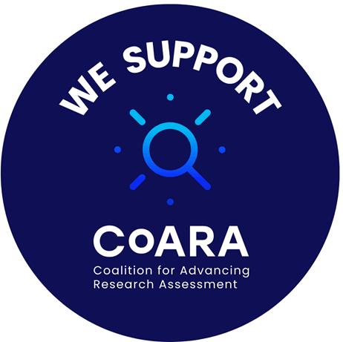


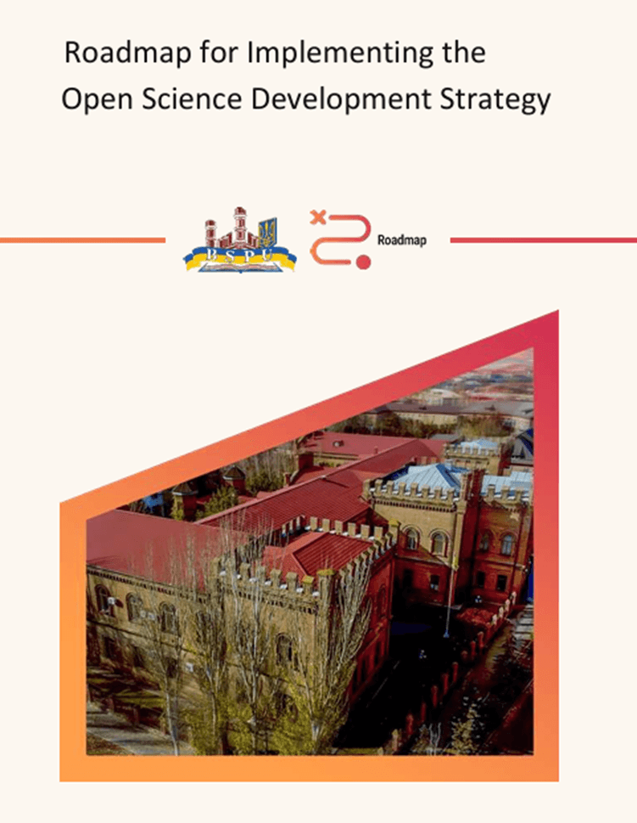
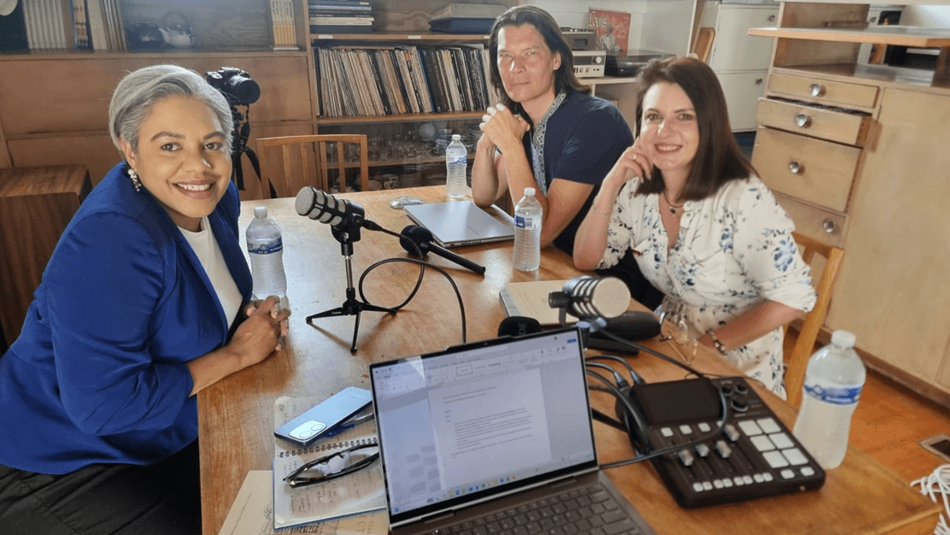

BSPU: responsible open science in a university without walls
Keeping research connected after displacement
CAPACITY — Who can participate? | DSpace, Zenodo and OJS support access and sharing. Training helps researchers use them
AUTHORITY — Who decides? | CARE in our strategy. Research ethics review addresses risks to people and communities
RESPONSIBILITY — Who safeguards research? | Data management plans required for research projects and first-year PhD students
BENEFIT — Whose contributions count? | DORA and CoARA commitments. Open datasets and preprints included in research reporting
doi.org/10.5281/zenodo.15007508
“
As open as possible, as closed as necessary
Podcast with Maree Meredith
(Strategic Advisor on First Nations Affairs, Australia; proud Bidjara woman)
A conversation on how the experiences of diverse communities — from Indigenous peoples to war-affected societies — are reshaping global
data ethics
University without walls — science without borders
From Data Loss to Data Responsibility: Safeguarding Scientific Information in Wartime Ukraine
Extending the CARE Principles: managing data for vulnerable communities in wartime and humanitarian crises

