Slide 1
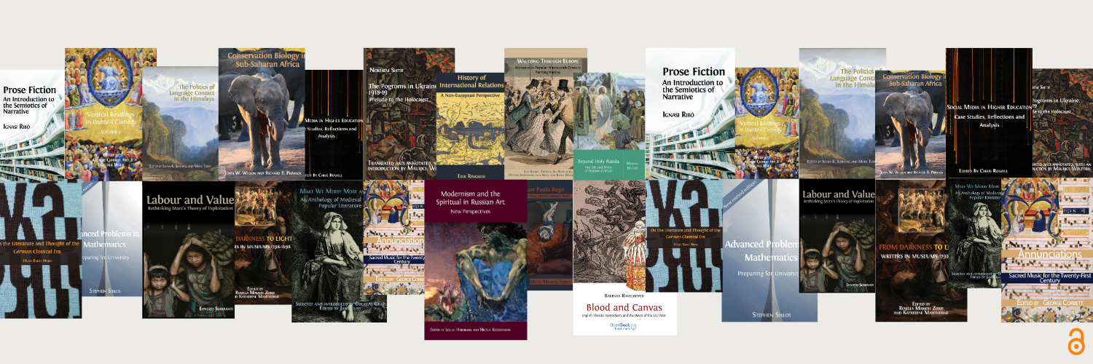

Diamond Open Access Books
with
Open Book Publishers
Lucy Barnes
openbookpublishers.com

Slide 2

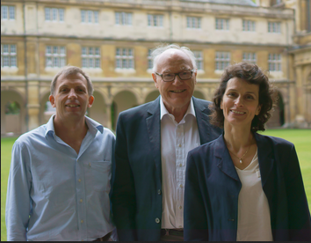
Open Book Publishers
Leading scholar-led, non-profit Open Access press
Founded in 2008 in Cambridge
Mission-driven: make high-quality academic books freely available everywhere
No charges to readers or authors
Rupert Gatti, William St Clair and Alessandra Tosi

Slide 3
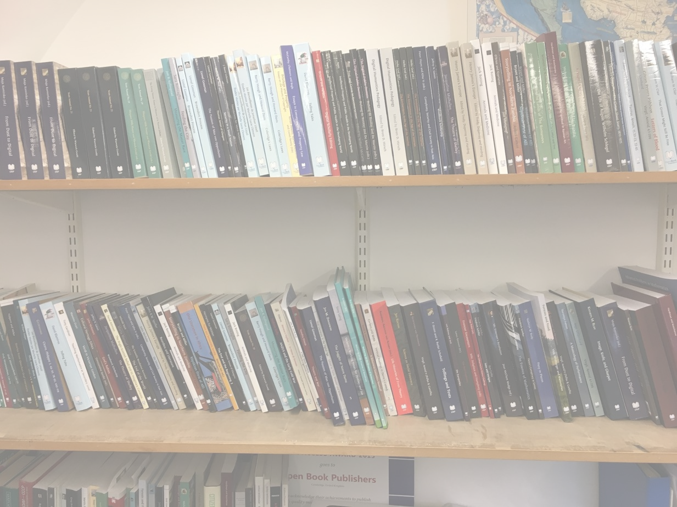

Our books
50 peer-reviewed books per year
Blind peer-review process:
  Proposals reviewed by Managing Editor and Board
  Full manuscript sent to at least two expert reviewers
All immediate OA:
  No embargo
  Creative Commons licence
  Free PDF, HTML editions; paid-for paperback, hardback, EPUB
Accessed worldwide over 80,000 times each month
Available via open platforms and sales routes
  Google Scholar, OAPEN, Open Edition etc
  Amazon, our website, bookshops, museums etc

Slide 4
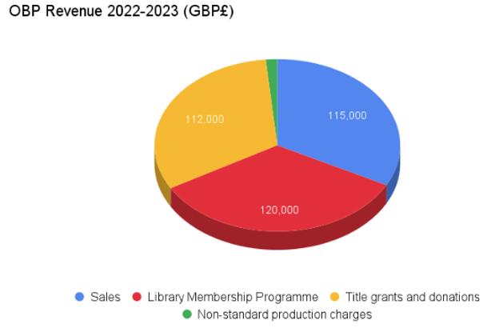
Costs and revenue
Financial year October 2022 – September 2023
Average cost per title: £5,500
49 titles (35 monographs, 15 edited collections
& 2 textbooks)
35 books had no funding attached
4 had partial funding; 10 were fully funded
Small surplus of about £13,000

Slide 5

Library Membership Programme
Over 270 library members
Libraries pay an annual fee for membership (tiered) (€400-800)
Free, perpetual access to our digital editions for anyone on the network, plus discounts on paper copies
Metadata, outreach
Funding OA books for everyone

Slide 6

Diamond: Challenges for authors
Knowledge
Prestige
‘Diamond for our institution’s authors’
But: models like ours being taken up by other presses too, sometimes on a list basis, including some larger university & commercial presses (MIT Press, Taylor & Francis, Bloomsbury)
Image by katemangostar on freepik

Slide 7
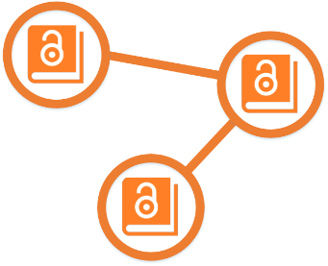







Collaboration is key
NUPs as an example
Likewise ScholarLed → Copim
Copim: Non-profit, open infrastructure to support OA books
Open Access Books Network: coordination

Slide 8

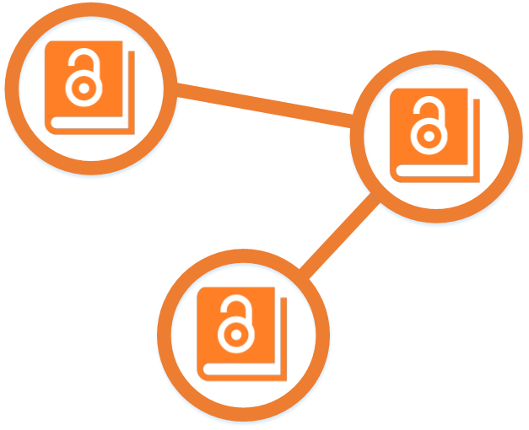

Knowledge and support
OAPEN OA Books Toolkit:
https://www.oabooks-toolkit.org/
Open Access Books Network (OABN):
https://oabooksnetwork.org/
OABN Author Resources:
https://openaccessbooksnetwork.hcommons.org/for-researchers/

Slide 9



Thank you for listening!
Any questions…?
lucy@openbookpublishers.com
www.openbookpublishers.com
@alittleroad.bsky.social

